Slide 1

Hotel Management
CSC 102
TOMAS NADER
THALES TEIXEIRA RODRIGUES

Slide 2




Classes in Hotel Management App
Room class
Customer class
Booking class
Hotel class

Slide 3

Class Room
Information Encapsulation: Encapsulates essential information about each room, including variables such as room number, room type, price per night, and available benefits.
Dynamic Details: Contains functions to change details such as room number, room type, price per night, and available benefits.
Information Retrieval: Provides functions to retrieve information about the room and its current status.

Slide 4
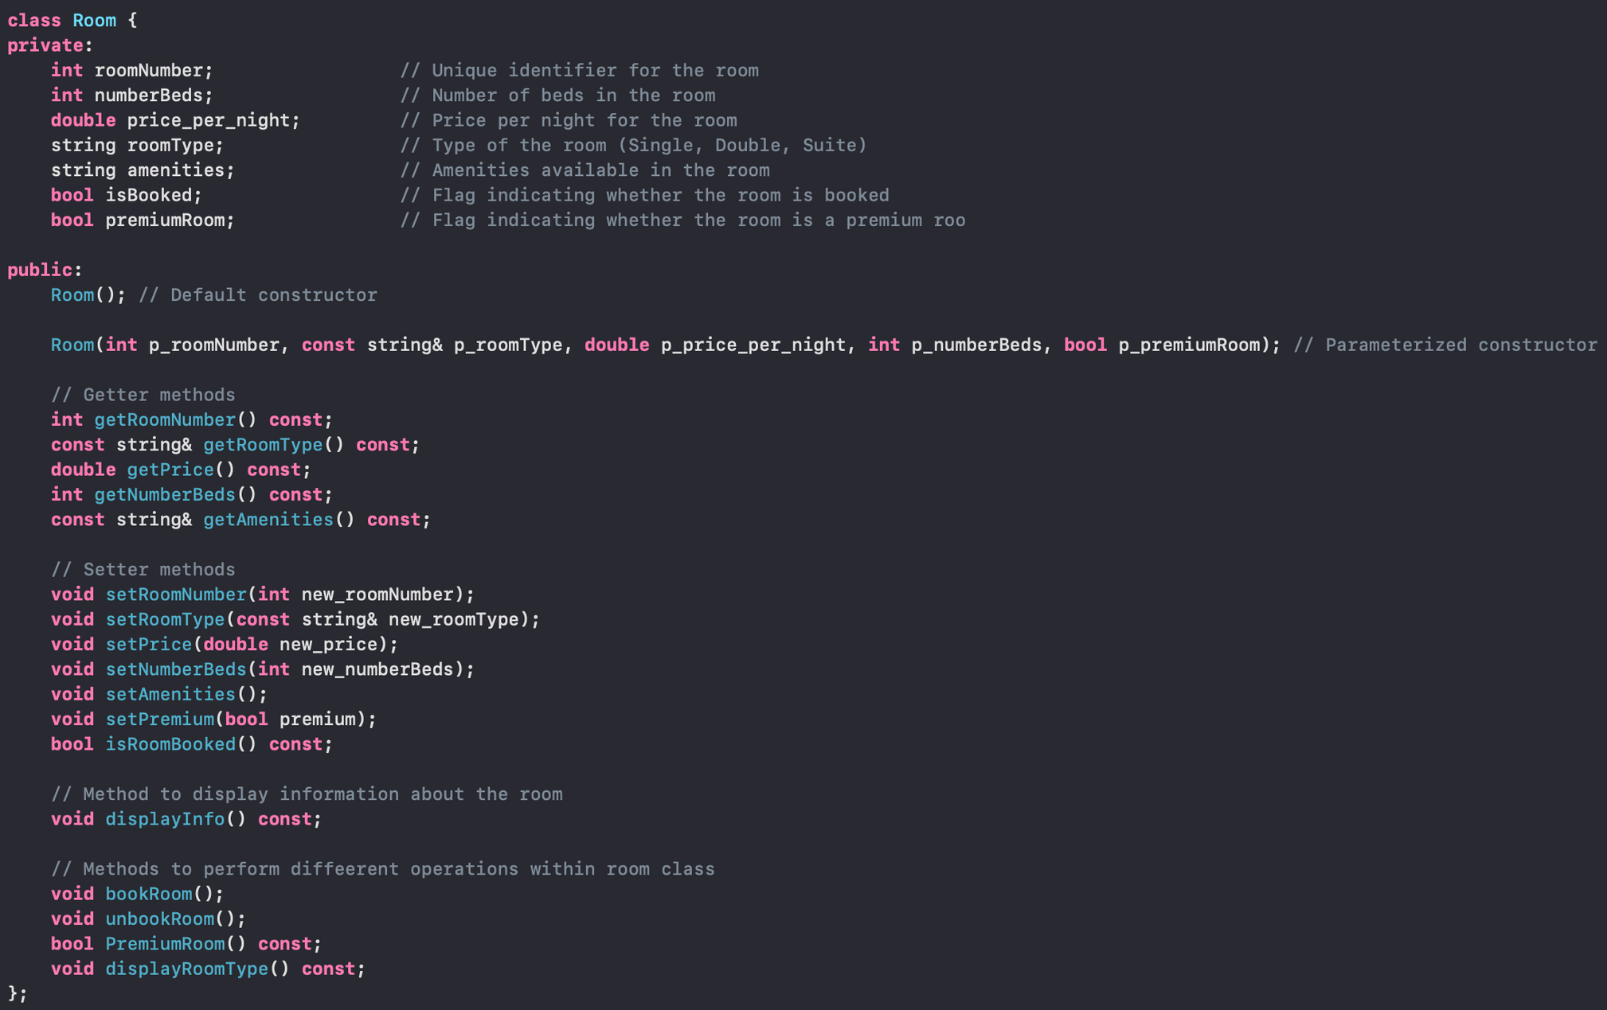

Slide 5

Class Customer
Information Storage: The Customer class's primary function is to store essential information about a hotel guest, including their name, age, phone number, address, and booking date.
Individual Customer Tracking: This enables the hotel management system to track customers.
Association with Room Reservations: Associates customers with specific room reservations, creating a link between guests and booked accommodations.
Personalized Services: The class plays a crucial role in providing personalized services to guests based on their stored information.
Booking Date Tracking: Allows the system to track and manage booking dates for each customer.
Guest Information Management: Forms a core component in managing and organizing information related to hotel guests.

Slide 6
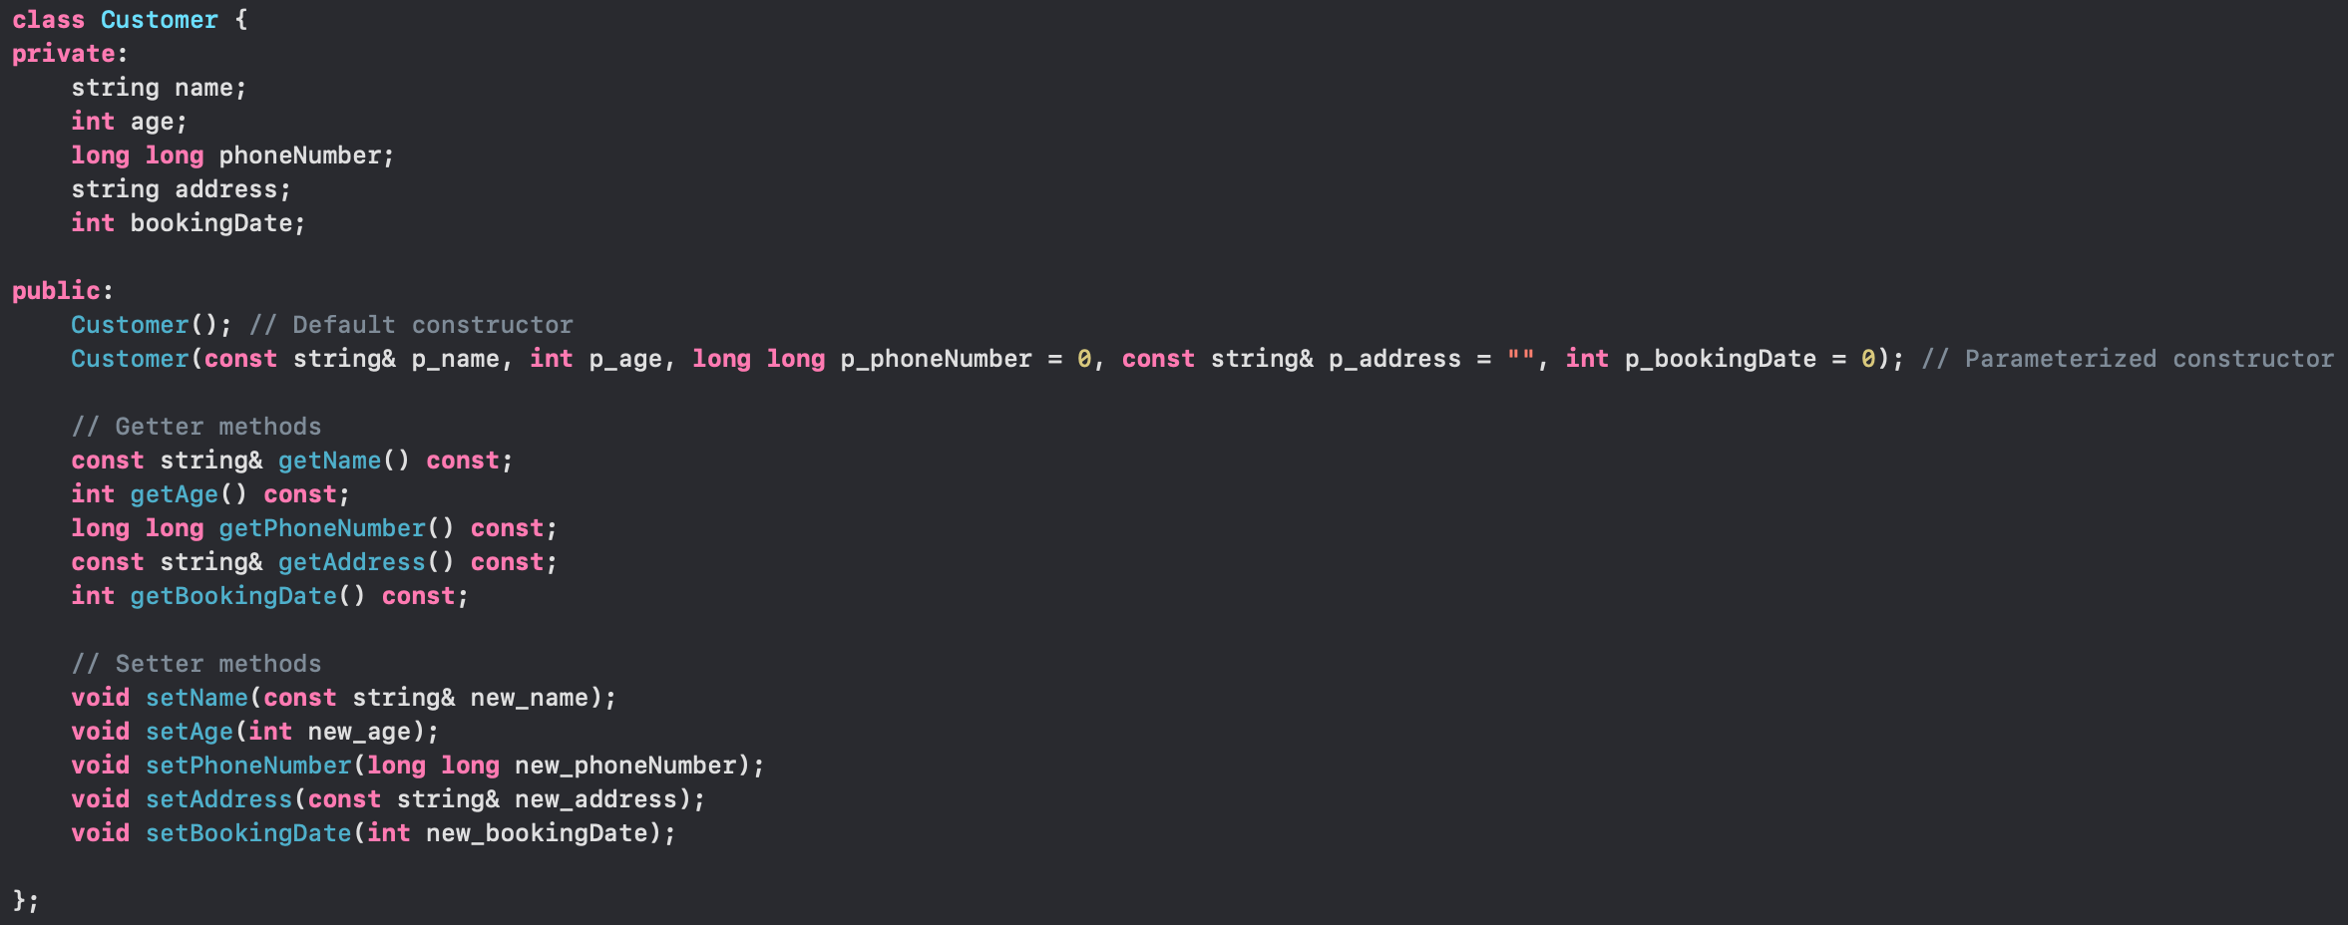

Slide 7

Class Booking
Connection Establishment: The Booking class's primary function is to connect a specific room and the corresponding customer.
Reservation Management: Enables effective management of reservations within the system.
Association for Tracking: Facilitates the association between rooms and customers, allowing the system to track bookings seamlessly
Reserved Room Information: Provides the capability to retrieve information about reserved rooms.
Customer Details Access: Allows access to details about the customers who made the reservations.
Information Retrieval: Supports the retrieval of comprehensive information related to both rooms and customers within the context of reservations.

Slide 8
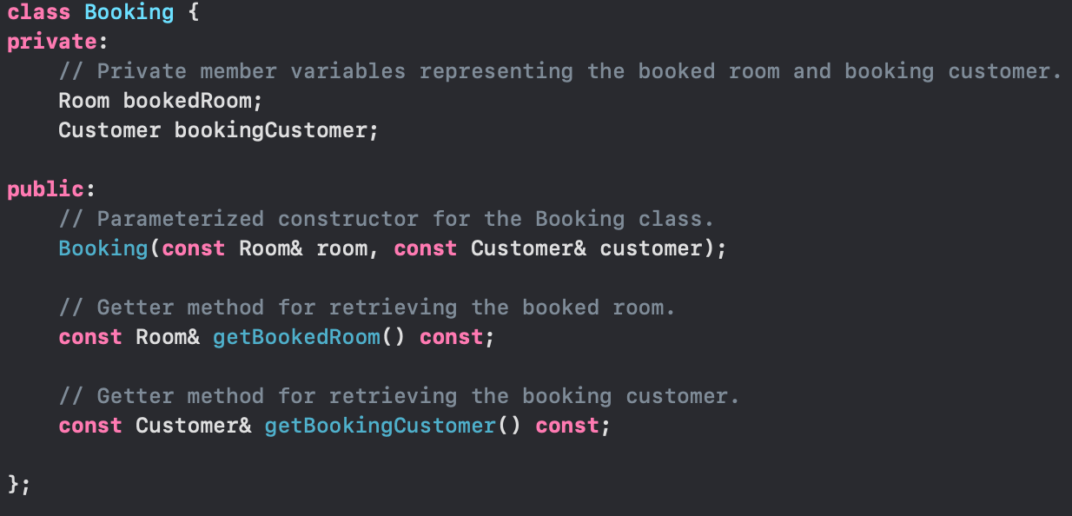

Slide 9

Class Hotel
Room and Booking Management: The Hotel class orchestrates the hotel system's management of rooms and bookings.
Book Tracking: This enables the hotel management system to track bookings seamlessly.
Access to Room Information: Facilitates access to information about reserved rooms and who reserved the room.
Customer Records: Maintains detailed records of customers responsible for reservations.
Effective Booking System: Contributes to establishing and maintaining an effective booking system within the hotel.
Association for Efficiency: The class associates rooms with customers, enhancing the efficiency of reservation-related tasks.
Comprehensive Information Retrieval: Allows complete retrieval of information related to rooms and customers in the context of reservations.

Slide 10
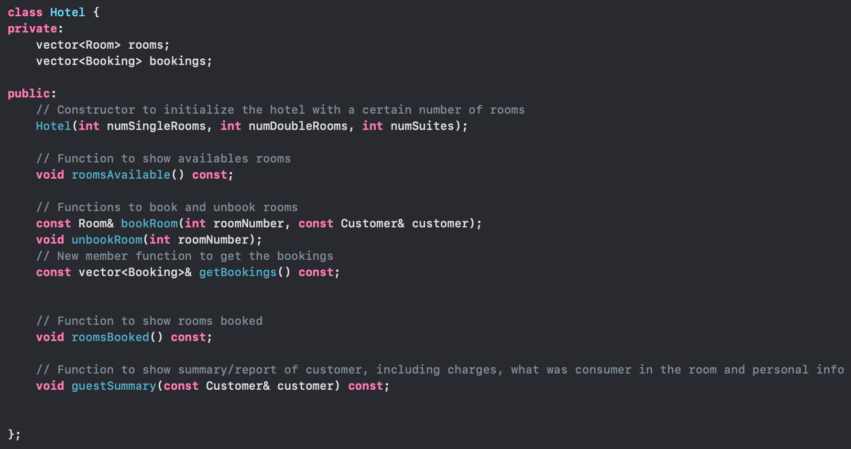

Slide 11

Main Menu
Interactive Interface: The Menu is an interactive interface.
User Communication: Facilitates communication between users and the program.
Display Available Rooms: Shows information about available rooms to the user.
Booking/Unbooking: Manages the booking and unbooking of rooms based on user input.
Guest Summaries: Provides summaries of guest-related information.

Slide 12
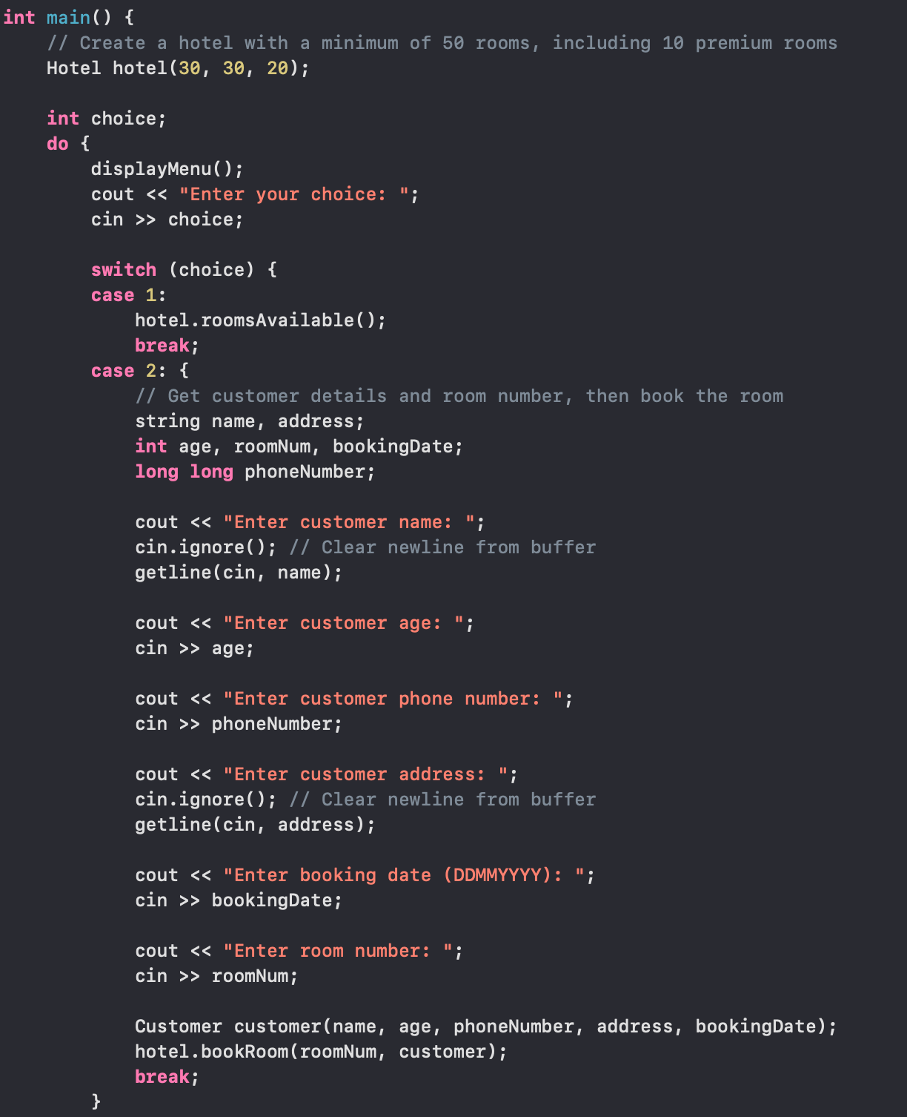
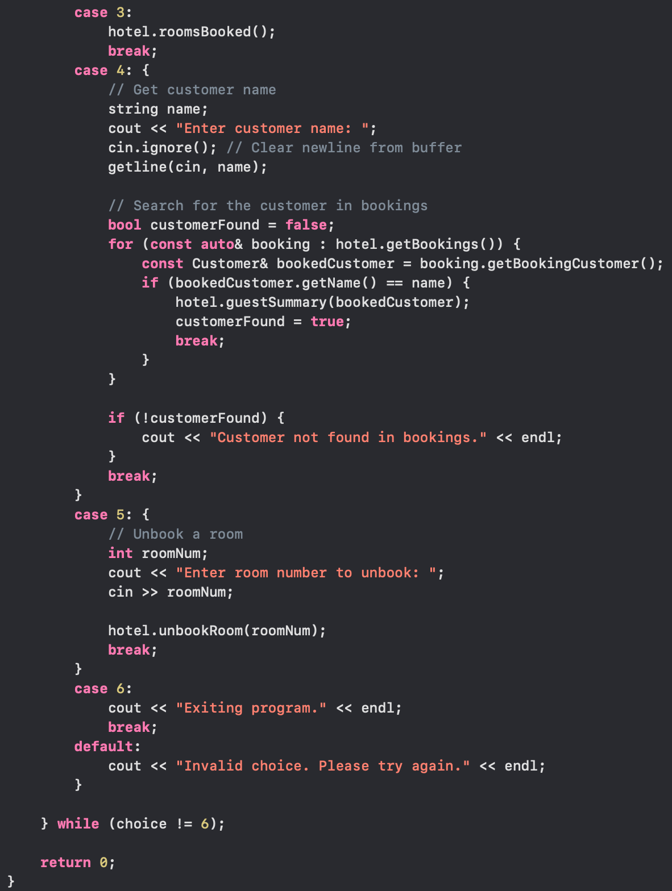

Slide 13



Obstacles
Limited Validation:
Error Handling:
Code Duplication:
The code assumes valid inputs in many places. Adding input validation for user inputs, such as age, phone number, and room number, would improve the robustness of the system.
The code lacks comprehensive error handling, especially in the bookRoom and unbookRoom functions. Adding proper exception handling would make the system more robust.
Some code snippets for user input where duplicated in the main function.

Slide 14


Further Enhancements
User Interface Improvement:
Persistence:
File reading:
Implement a mechanism to persist data, such as room and booking information, between program executions.
Read customer information from a file. Data entry can be simplified by allowing users to prepare customer information in a structured file format and then import it into the system. This reduces manual data entry errors and saves time.
Enhance the user interface with clearer prompts and messages to guide users through the interaction.
Logging:
Extended Functionality:
Introduce a logging mechanism to record significant events or errors during program execution.
Add features like searching for available rooms based on criteria, modifying bookings, and handling different room rates based on seasons.
Charges:
Provide a mechanism for customers to make payments and to display room charges so the customer is able to purchase things from the room.
Database Integration:
Integrate a database to store and retrieve hotel-related data for scalability and ease of management.

Slide 15
Any Questions?
Thank you

